Slide 1





Tutorial T8
Models 2018, Copenhagen, Denmark
Franck Fleurey, Brice Morin and Jakob Høgenes

Slide 2

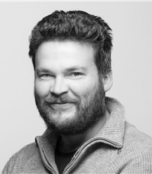

Who are we?
Franck Fleurey, Brice Morin and Jakob Høgenes

Slide 4
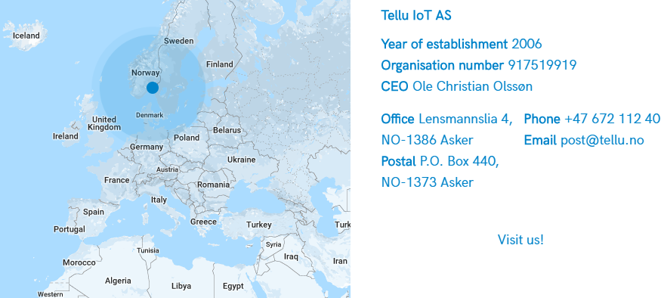
Norwegian SME
Asker, Norway
IoT platform TelluCloud
For eHealth and personal security applications
15 employees
Growing
SINTEF TTO as Investor
http://www.tellucloud.com

Slide 5
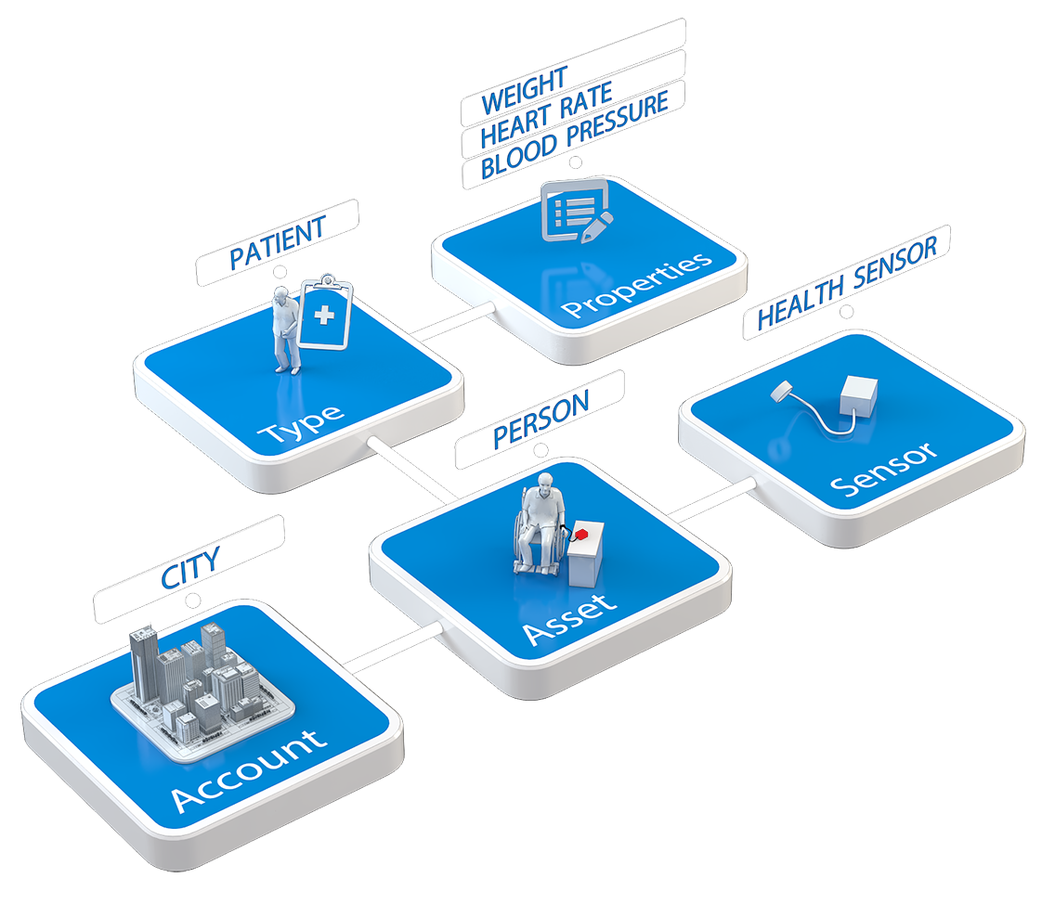
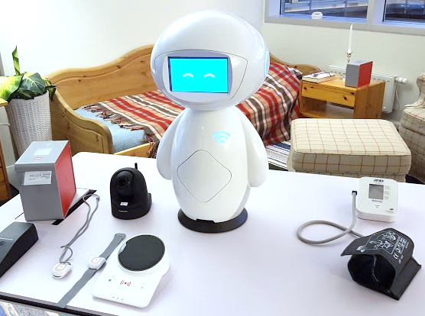
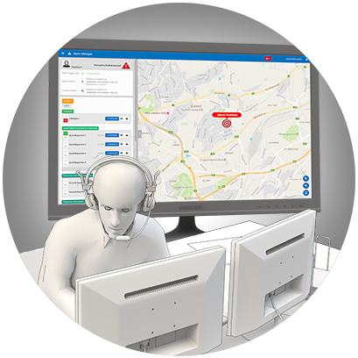

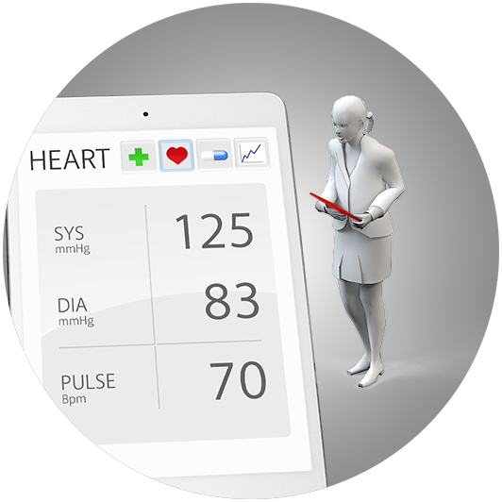
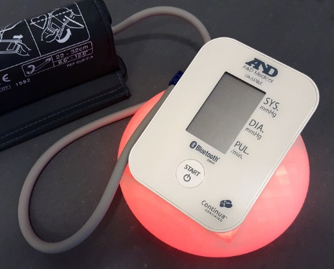
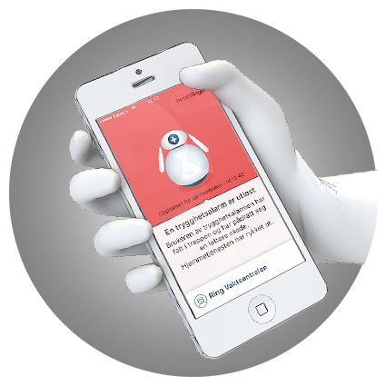
Tellu delivers…
Digital eHealth Platform
Care Alarms
Medical Gateway
Digital supervision
Integration with medical systems
Patient Journals
Hospital systems
Security and privacy
GDPR Compliance
Information Security
Certification (ISO 13485)
Research and Innovation
Participation in R&D projects
Prototyping of Devices and Services
Consultancy
Example applications
Diabetes patients (self-monitoring)
Dialyse patients (hospital / home)
Elderly care (Institution / home)

Slide 6
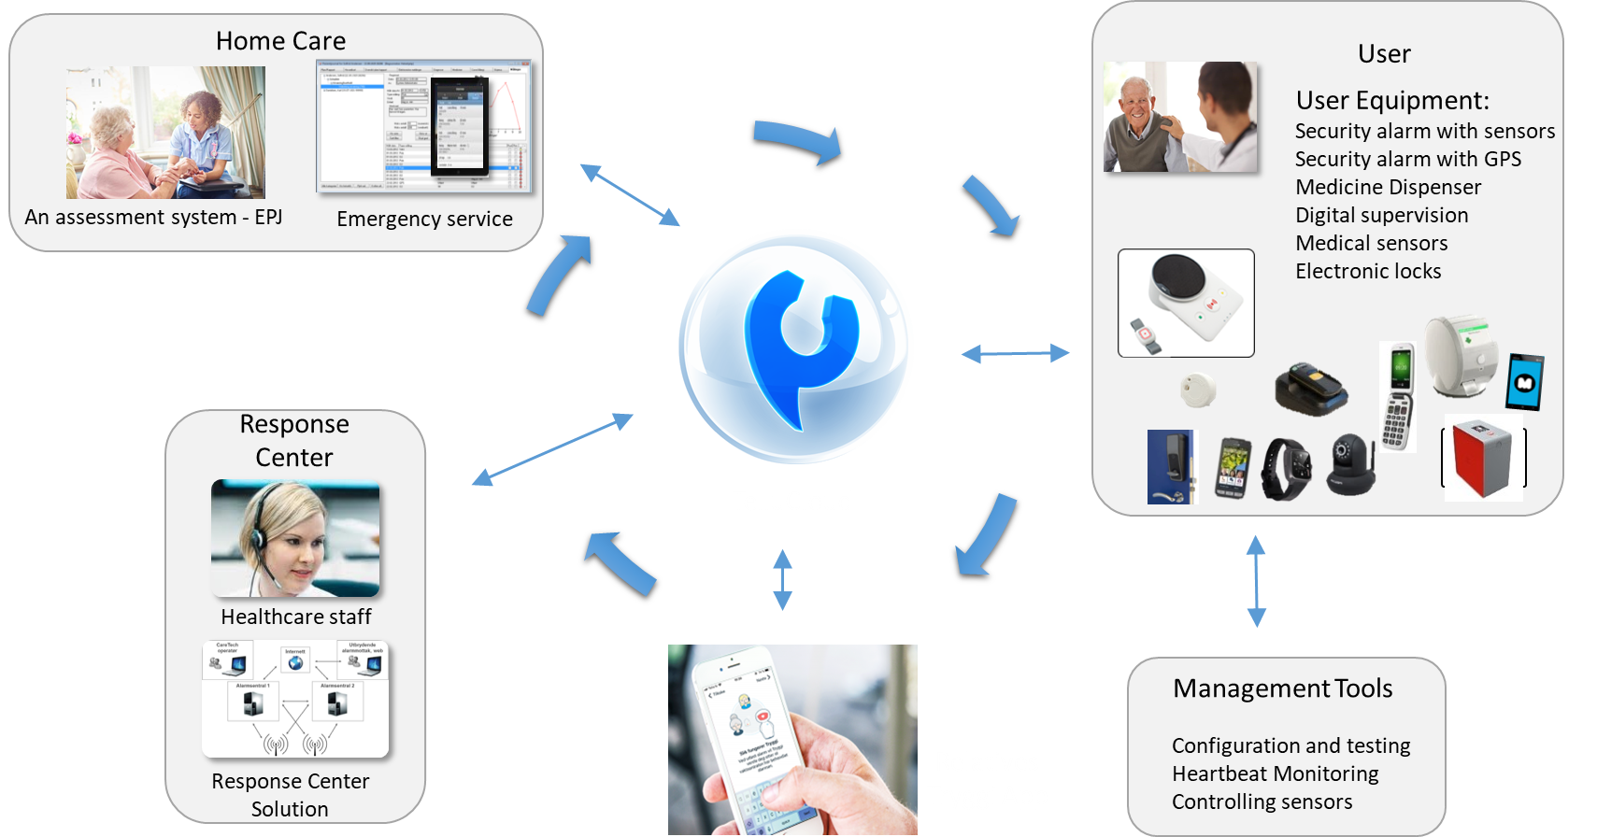
Example: eHealth for Norwegian Municipalities

Slide 7
Tutorial Topics / Goals
SE Challenges for IoT / Cyber-Physical Systems
The ThingML approach / toolset
Applying MDE for building CPS
As a platform to support Research
Experiences and lesson learned
Building and tooling a DSML
Practical use of MDE with developers with different backgrounds
Hands-on exercises with the ThingML tools
Discussions / Questions

Slide 8

Who are you?
What type of institution do you come from?
What do you expect from this Tutorial?
How are you hoping to benefit from ThingML?
Use it?
Contribute to it?
Extend it for your research?

Slide 9


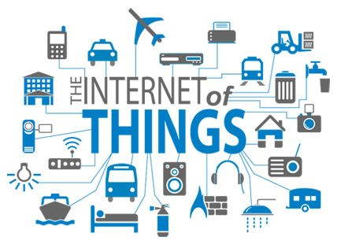
What Is ?
A Language to model distributed reactive systems
IoT systems, embedded systems, sensor networks, ...
Originally developed by SINTEF and transferred to Tellu in 2017
Remains fully open-source (https://github.com/TelluIoT/ThingML )
Components, State machines, asynchronous messaging and action language
« Main stream » Software Modelling (based on UML concepts)
Contribution of ThingML
« Complete » action language to fully generate target code
A set of "equivalent" code generators for different platforms
Wide coverage of target platforms (microcontrollers to servers)
Easy to extend to support legacy / proprietary components

Slide 10
Timeline of
Development
Pilots and use-cases
Production

Slide 11
ThingML Versions / Iterations
Iteration 1 (~2009)
"3 layers architecture", generate APIs
Re-use existing modelling languages / tools
Target mostly resource constrained devices
Iteration 2 (~2012)
"Complete" DSML (with action language)
Full code generation + communication APIs
Target wider range of platforms
Iteration 3 (~2015)
"Blending" of target platform and legacy code
Code generation framework with plug-in mechanism

Slide 12
ThingML Versions / Iterations
Iteration 1 (~2009)
"3 layers architecture", generate APIs
Re-use existing modelling languages / tools
Iteration 2 (~2012)
"Complete" DSML (with action language)
Full code generation + communication APIs
Iteration 3 (~2015)
"Blending" of target platform and legacy code
Code generation framework with plug-in mechanism
Sensor Networks

Slide 13
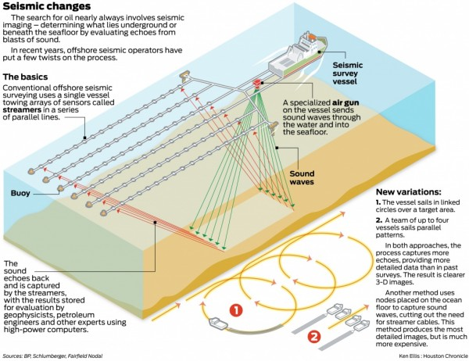

Slide 14
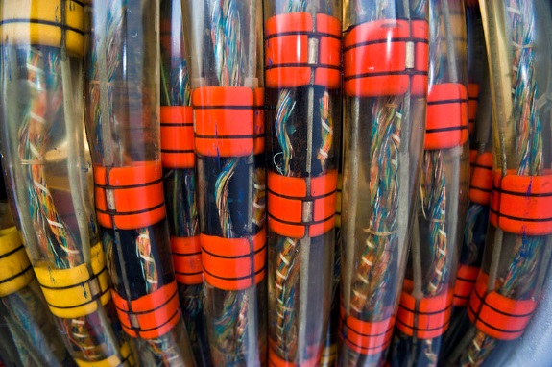
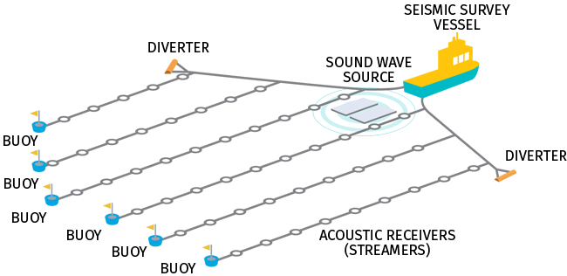

Seismic acquisition software
Heterogeneous network of devices
Servers, routers, microcontrollers, DSPs…
IP, Ethernet, Serial, proprietary protocols
Parallel development teams
Languages, libraries, platforms…
Hardware / Software
Developed in parallel
Strict requirements
Reliability / Safety
Time to Market
(Image: Wikipedia)
~ up to 10 km long
~ 100k distributed devices
~ 10 types of devices
~ 5 different networks
~ 10 Gbit/s data rate
(Image: Kongsberg)

Slide 15
EDAP Idea: A layered appraoch
State Machines
APP 1
APP 2
Applications
Domain Model
Domain (Nodes and Messages)
PIM
PSM
Hardware specific drivers
Driver 1
Driver 3
Hardware
Driver 2
Sensors
Nodes
Platform specific models
Actuators
Networks

Slide 16
Step 1 : Modeling the domain

Slide 17
Step 2: Generation of the domain layer

Slide 18
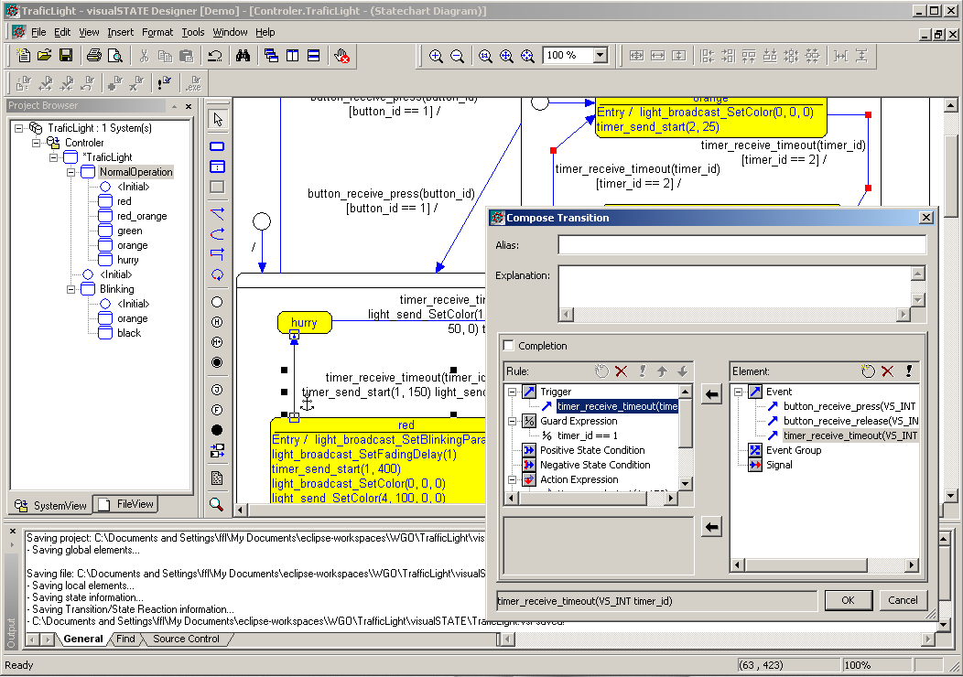
Step 3: Using Existing tools for modeling the application
IAR visualSTATE

Slide 19
Importing the domain in IAR visualSTATE
Generated from the EDAP domain model

Slide 20
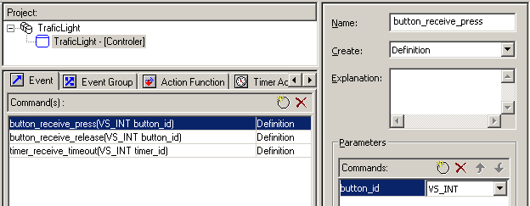
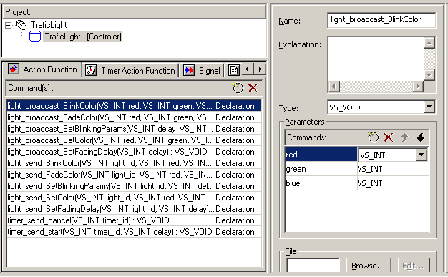
Imported domain in IAR visualSTATE

Slide 21
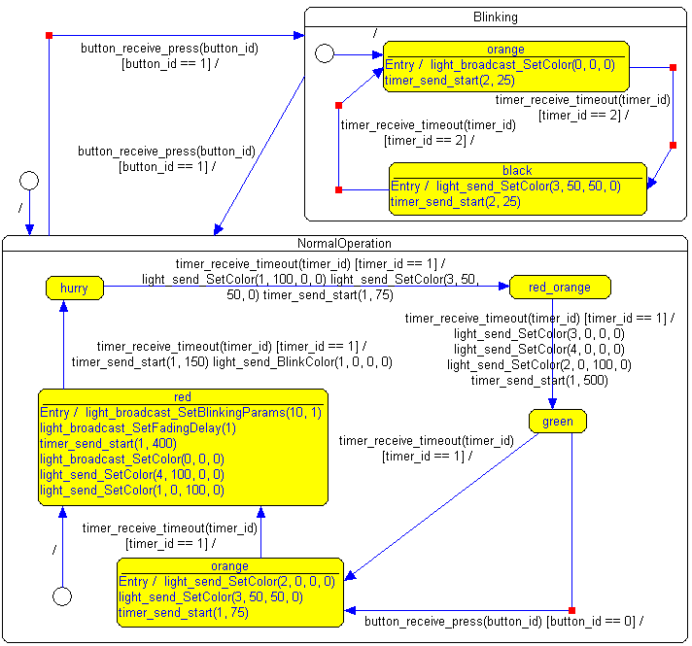
Step 4: Modeling the application

Slide 22
Step 5: Putting it together (1)
Complete the hardware driver code manually
Use IAR visualSTATE built-in code generator for AVR controllers
The generated domain layer handles all interactions between the application generated code and the hardware driver
Compile C code with avr-gcc

Slide 23
Step 5: Putting it together (2)
The «main» just needs to initialize the application

Slide 24
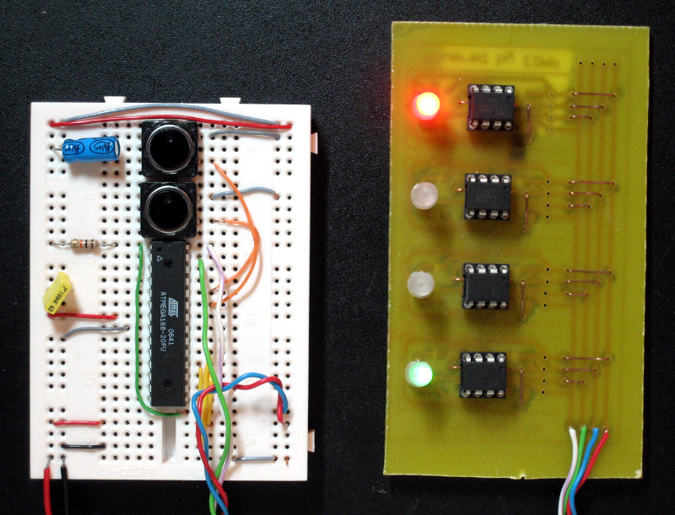
It worked…

Slide 25
But, it was not ready for adoption:
A set of case studies implemented
Working with different developers
UML Profile vs Domain Specific Language
Graphical vs Lexical Concrete Syntax
Generate code skeletons
Quality of generated code
Using Existing MDE and UML tools
Template based code generators
Work with / Integrate a set of tools

Slide 26
ThingML Versions / Iterations
Iteration 1 (~2009)
"3 layers architecture", generate APIs
Re-use existing modelling languages / tools
Iteration 2 (~2012)
"Complete" DSML (with action language)
Full code generation + communication APIs
Iteration 3 (~2015)
"Blending" of target platform and legacy code
Code generation framework with plug-in mechanism

Slide 27
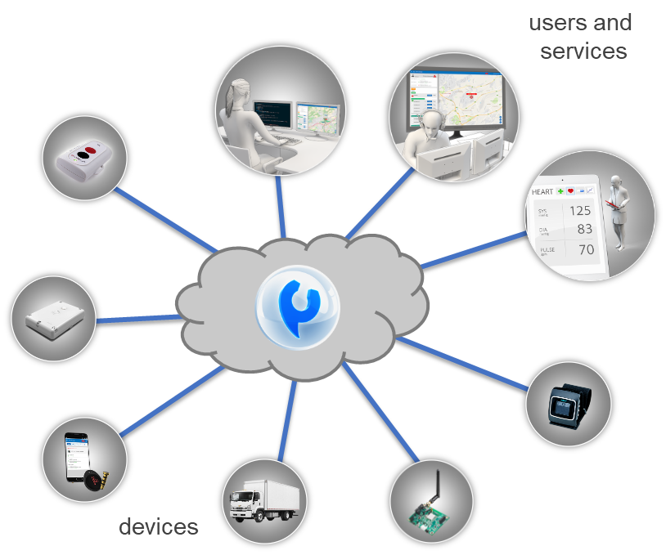

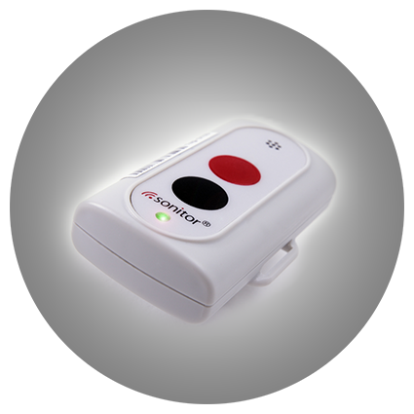
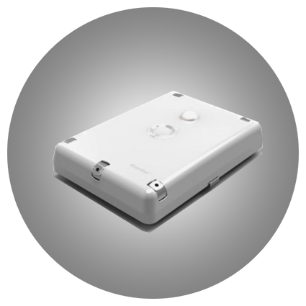

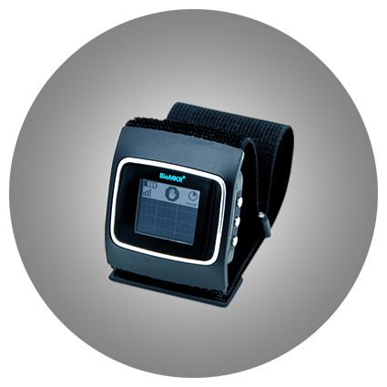
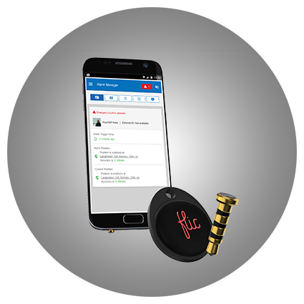
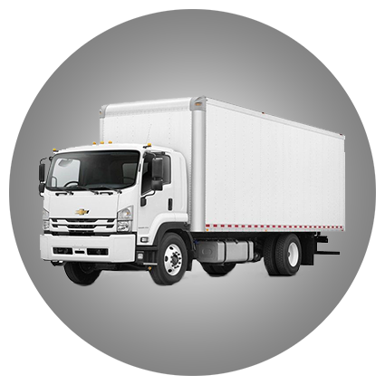
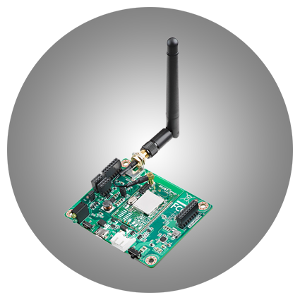
Internet of Things 1.0 - Centralized
users and
services
Device integration
Connectivity
Centralized architecture
Generic Platforms
Silo Services and Apps
“Simple” Business Logic
devices

Slide 28
Internet of Things 2.0 - Distributed
Exploit features of each platforms
Local and/or decentralized logic
Robust to partial/temporary failures
Allow for real-time and critical services
Can scale in a "big data" context
Importance of legacy
Importance of Integration
Continuous deployment
Partner
External service
Legacy
Proprietary product
Challenges
Things
Heterogeneity
Resource Constraints
Data processing
Security / Privacy
Distribution
Deployment / Testing

Slide 29
Goals
Provide MDE tools and methods for IoT 2.0 Systems
For each actor to concentrate on his task
For decoupling the tasks of different actors
Using state of the art software engineering practices
Modularity, reusability, runtime deployment, continuous integration, validation, etc…
Cost efficient and practically usable
No large overhead, integrated with legacy systems, etc…
Model-based to support analysis
E.g. facilitate certification, safety analysis, etc

Slide 30
Design choices
One integrated modelling language
More generic architecture models
Includes a platform independent action language
Includes a simple "kick-down" to integrate manually written code in the model
Generated "complete" modules

Slide 31
Result
Complete Domain Specific Language
Textual notation
Graphical visualization
Fully compliant with UML 2 (Subset)
Component types
State machines
Asynchronous messages
Adds an action language
Imperative
Easy integration with platform code and libraries
Code generation framework to different platforms

Slide 32
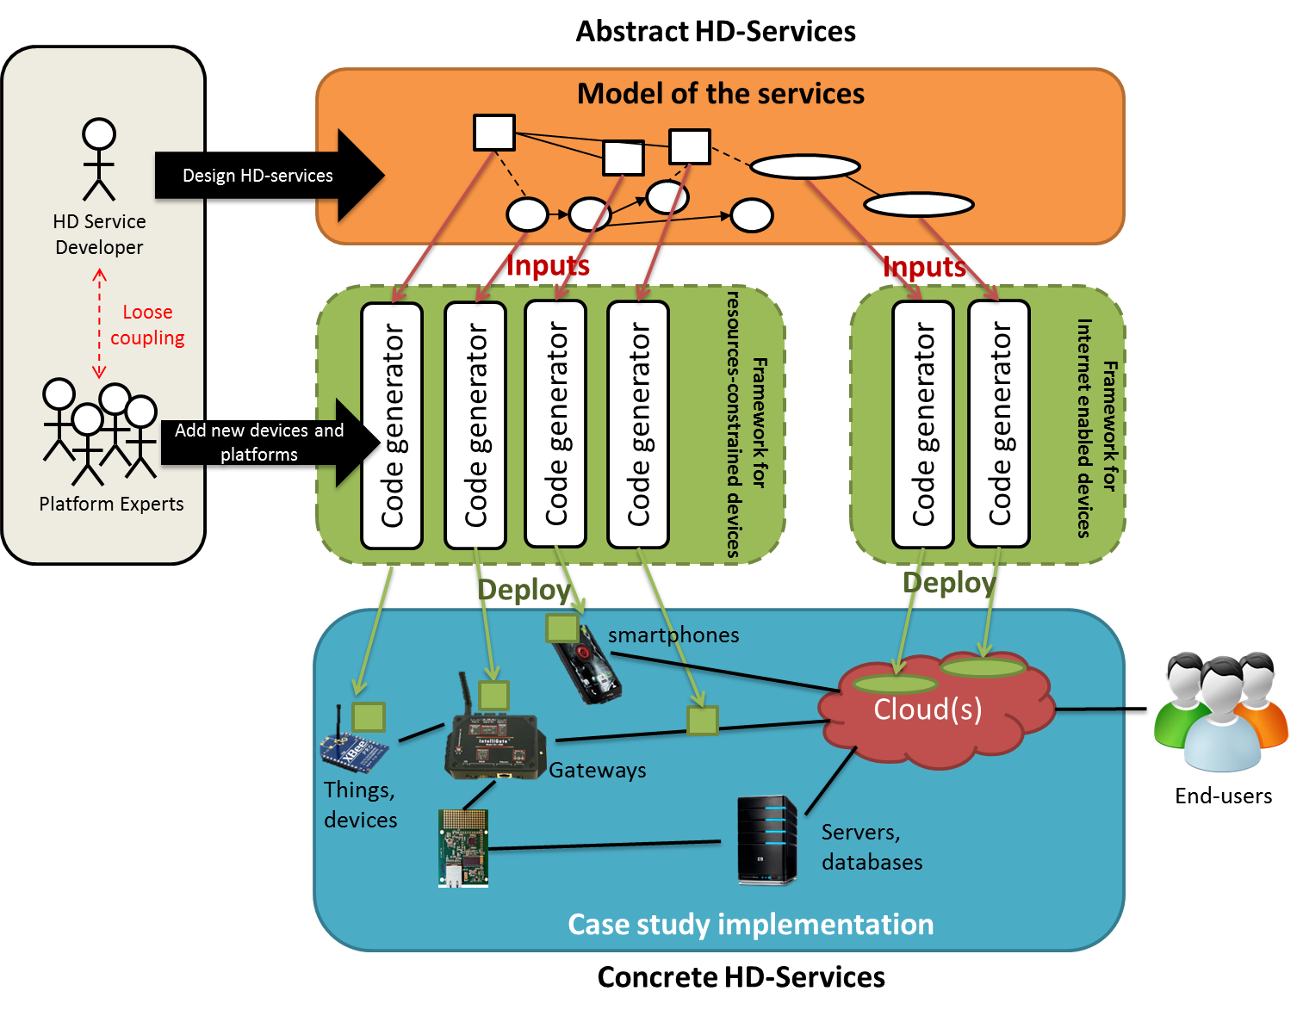
ThingML Code Generators

Slide 33
Hello World

Slide 34
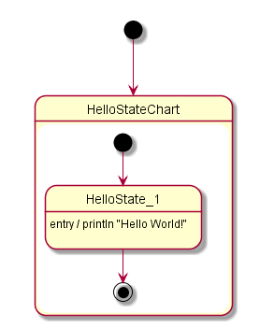
ThingML: Hello World
thing HelloThing {
statechart HelloStateChart init HelloState {
final state HelloState {
on entry println "Hello World!"
}
}
}
configuration Hello {
instance hello : HelloThing
}

Slide 35
ThingML: Hello World
thing HelloThing {
statechart HelloStateChart init HelloState {
final state HelloState {
on entry println "Hello World!"
}
}
}
configuration Hello {
instance hello : HelloThing
}

Slide 36
ThingML: Hello World
thing HelloThing {
statechart HelloStateChart init HelloState {
final state HelloState {
on entry println "Hello World!"
}
}
}
configuration Hello {
instance hello : HelloThing
}

Slide 37

ThingML: Hello World
thing HelloThing {
statechart HelloStateChart init HelloState {
final state HelloState {
on entry println "Hello World!"
}
}
}
configuration Hello {
instance hello : HelloThing
}

Slide 38

ThingML: Hello World
thing HelloThing {
statechart HelloStateChart init HelloState {
final state HelloState {
on entry println "Hello World!"
}
}
}
configuration Hello {
instance hello : HelloThing
}

Slide 39





ThingML: Hello World
thing HelloThing {
statechart HelloStateChart init HelloState {
final state HelloState {
on entry println "Hello World!"
}
}
}
configuration Hello {
instance hello : HelloThing
}
Code generators
Platform independent model

Slide 40
Hands-on 1
Installing the tools and Hello World

Slide 41
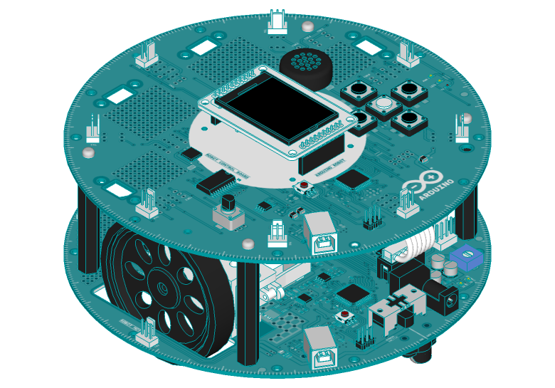
Language
Robot Example

Slide 42
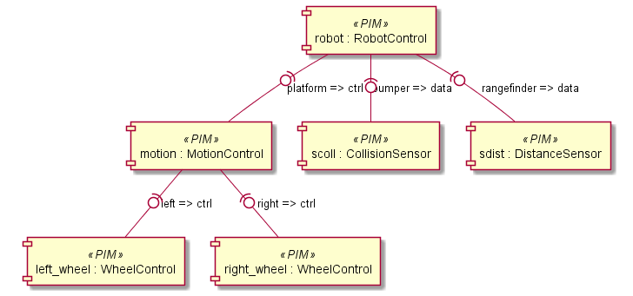
Robot Software Architecture

Slide 43
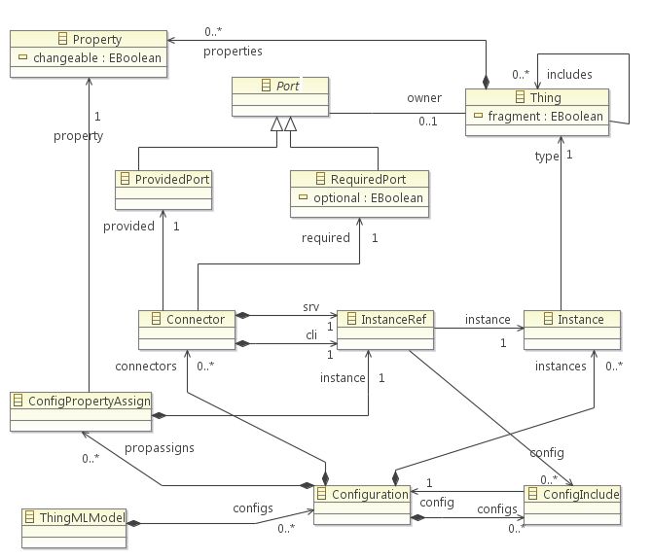

Slide 44
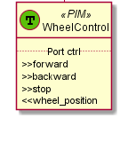
Architecture: Component Types
Component type
or Thing
thing WheelControl includes RobotMsgs {
provided port ctrl {
sends wheel_position
receives forward, backward, stop
}
}
Instance of
instance left_wheel : WheelControl
instance right_wheel : WheelControl
Component instances

Slide 45
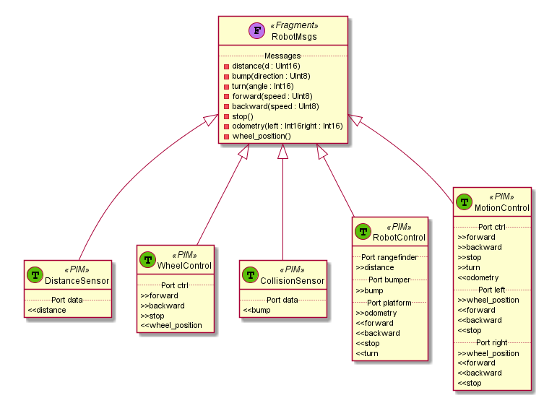
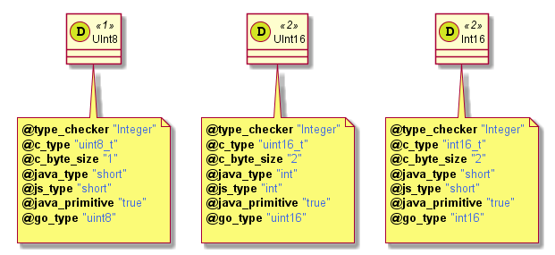
Component Types
thing fragment RobotMsgs
{
message distance(d : UInt16)
message bump(direction : UInt8)
message turn(angle : Int16)
message forward(speed : UInt8)
message backward(speed : UInt8)
message stop()
message odometry(left : Int16, right : Int16)
message wheel_position()
}
Fragment
Datatypes
Component type
or Thing

Slide 46
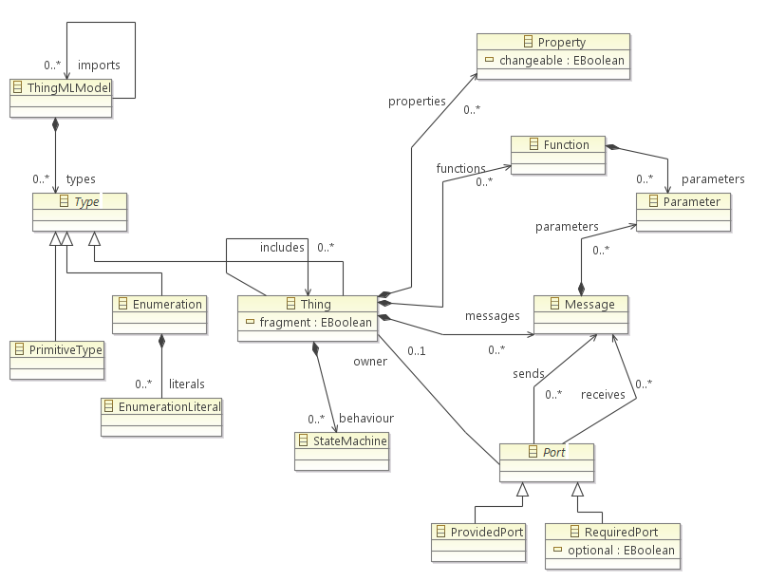

Slide 47
Component assembly (Configuration)
configuration Robot
{
instance robot : RobotControl
instance sdist : DistanceSensor
instance scoll : CollisionSensor
instance motion : MotionControl
instance left_wheel : WheelControl
instance right_wheel : WheelControl
connector robot.rangefinder => sdist.data
connector robot.bumper => scoll.data
connector robot.platform => motion.ctrl
connector motion.left => left_wheel.ctrl
connector motion.right => right_wheel.ctrl
}

Slide 48
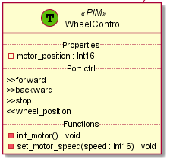
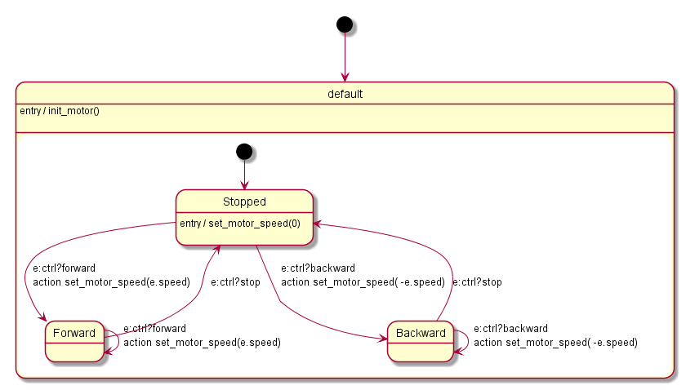
Component behaviour modelling
State Machine
Properties and
Functions

Slide 49
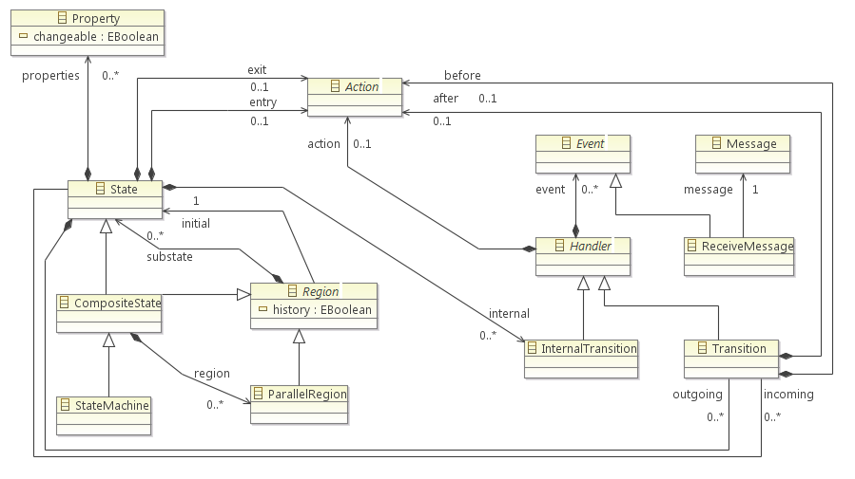

Slide 50
Properties and Functions
thing WheelControl includes RobotMsgs {
[…]
property motor_position : Int16
function init_motor() do
// Do initialise the motor controller
end
function set_motor_speed(speed : Int16) do
// Do set motor speed
end
[…]
}
All functions are private to the component and all properties are private to instances

Slide 51
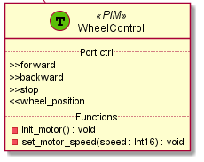
State machine
statechart init Stopped {
on entry init_motor()
state Stopped {
on entry set_motor_speed(0)
transition -> Forward event e : ctrl?forward action set_motor_speed(e.speed)
transition -> Backward event e : ctrl?backward action set_motor_speed(-e.speed)
}
state Forward {
transition -> Forward event e : ctrl?forward action set_motor_speed(e.speed)
transition -> Stopped event e : ctrl?stop
}
state Backward {
transition -> Backward event e : ctrl?backward action set_motor_speed(-e.speed)
transition -> Stopped event e : ctrl?stop
}
}
State Machine
Functions

Slide 52
Expressions and Action Language
Functions
States (on entry / on exit)
Transitions (guard / action)

Slide 53
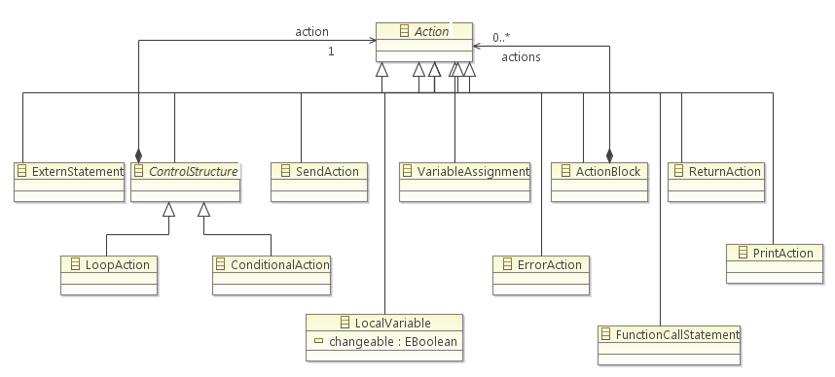

Slide 54
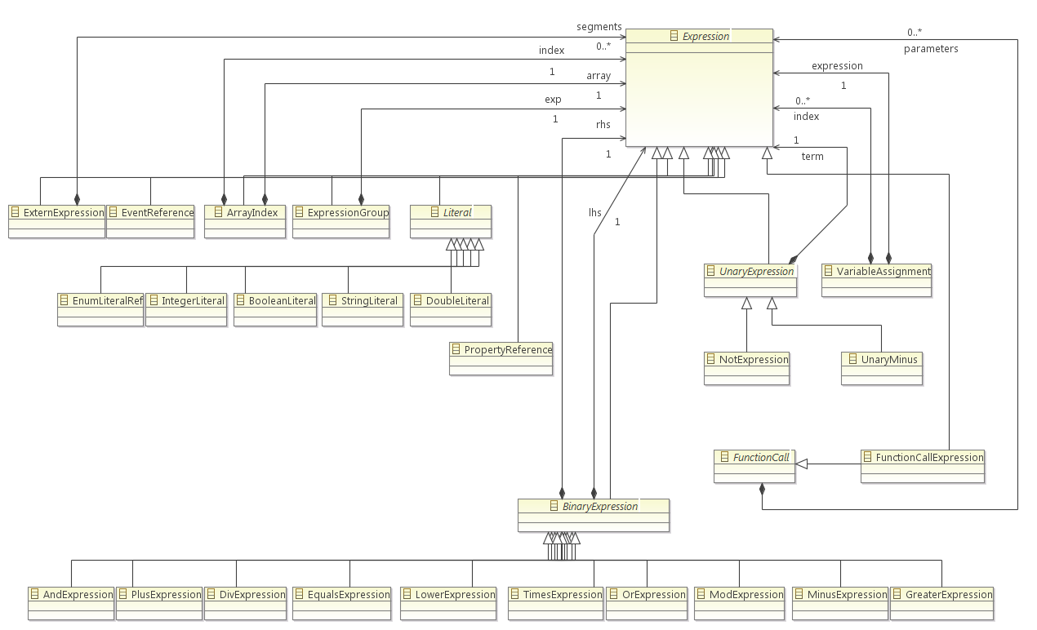

Slide 55
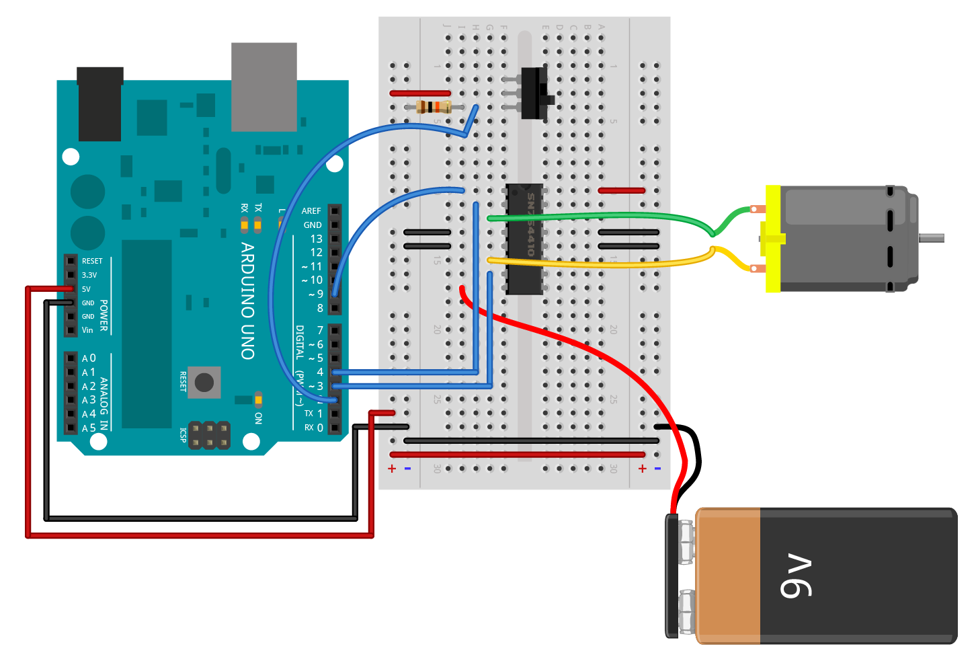
Platform code
function init_motor() do
`pinMode(9, OUTPUT);
pinMode(3, OUTPUT);
pinMode(4, OUTPUT);
digitalWrite(3, LOW);
digitalWrite(4, HIGH);
analogWrite(9, 0);`
end
function set_motor_speed(speed : Int16) do
if (speed == 0) `analogWrite(9, 0);`
else if (speed > 0) do
`digitalWrite(3, LOW);
digitalWrite(4, HIGH);
analogWrite(9, `& speed &`);`
end
else do
`digitalWrite(3, HIGH);
digitalWrite(4, LOW);
analogWrite(9, `& -speed &`);`
end
end
Arduino motor controller

Slide 56
Mixing ThingML and platform code
`platform specific expression or statement`
“Copy-pasted” as-is by the code generator
Allows freely mixing ThingML Actions with platform actions
Allows using ThingML expressions in platform code
function set_motor_speed(speed : Int16) do
if (speed == 0) `analogWrite(9, 0);`
else if (speed > 0) do
`digitalWrite(3, LOW);
digitalWrite(4, HIGH);
analogWrite(9, `& speed &`);`
end
else do
`digitalWrite(3, HIGH);
digitalWrite(4, LOW);
analogWrite(9, `& -speed &`);`
end
end
`analogWrite(9, 0);`
`analogWrite(9, `& speed &`);`

Slide 57
Hands-on 2
Ping Examples and Timers

Slide 58
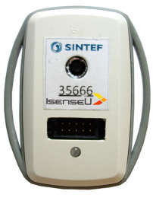
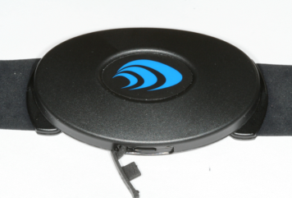
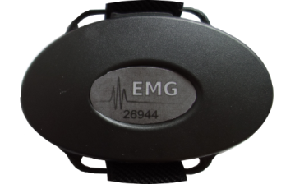
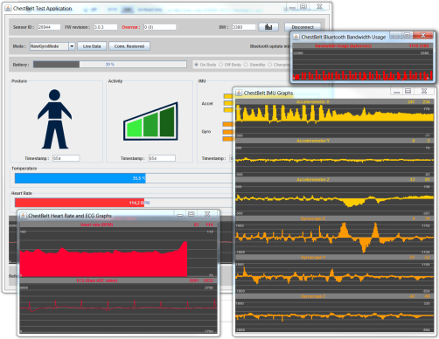
Evaluation
For iteration 2

Slide 59
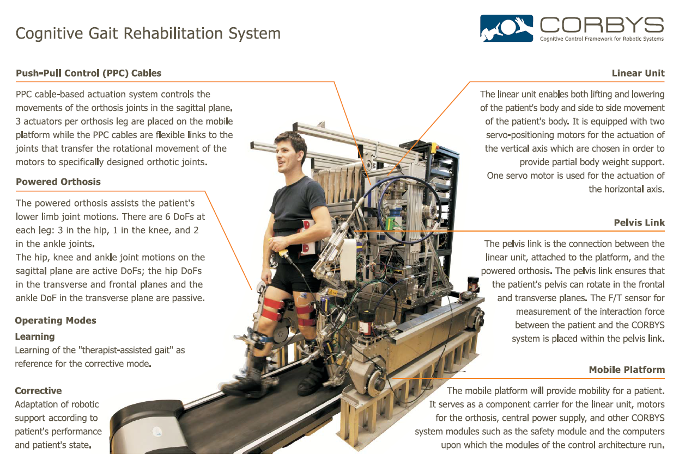

Slide 60
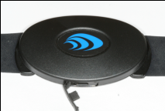
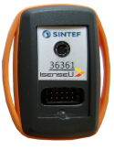

Wearable sensors for rehabilitation robot
Engineer GUI
1x
HSS Controller
Chest Unit
Driver
Parameter
Server
Chest Unit
Sensors
HSS_Chest_Phi
HSS_Chest_IMU
HSS_Chest_ECG
Bluetooth
2x
HSS
Front-end
IMU Sensor
Driver
HSS_Back_TH
HSS_Back_IMU
Config_Data
CORBYS
GPN
IMU
Sensors
BLE
HSS_Env_TH
HSS_Env_IMU
Sensor_Data_HSS
Heart_Beat
4x
EMG
Driver
HSS_EMG_TL
HSS_EMG_BL
HSS_EMG_TR
HSS_EMG_BR
EMG
Sensors
Bluetooth
5-10 KLOC of ThingML

Slide 61
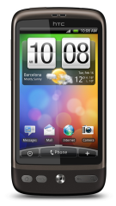

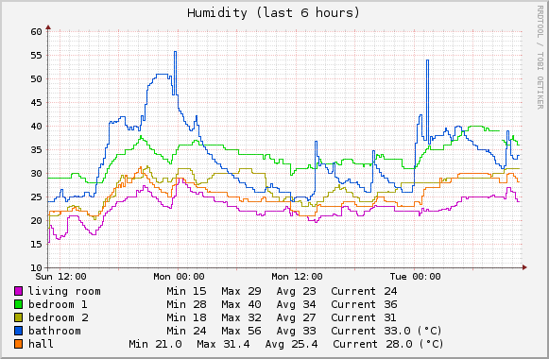











IoT Building automation
Visualisation
Server
(Registration, Discovery, Composition, Execution, Visualization)
Adaptive Applications
(mobile or not)
Adapter
Adapters from
commercial sensor
networks to sensapp
Adapter
TI ThingML
Intelligent
Gateway
ThingML
Waveman
Bridge
Commercial
Gateway
(Software)
Commercial
gateway
(hardware)
TI Adaptive
ThingML Sensors
Temperature, Light, …
Commercial home
automation devices
Commercial Sensors
Temperture, energy, …

Slide 62

The ThingML tools
Based on Eclipse / EMF Metamodel
Textual Syntax with EMFText
For good usability and productivity
To keep the development cost of the editor(s) reasonable
Graphical exports (UML)
Static well formedness and type checker
Equivalent compilers for a set of platforms
C/C++ for different microcontrollers, linux
Java for computers, smartphones, …
Javascript (NodeJS)
Generators for communication channels
Easy to distribute ThingML IDE
Standalone and lightweight IDE
Eclipse plugins

Slide 63
Consistency checking
A suite of tests written in ThingML
Takes characters as inputs (or nothing)
Generates characters as outputs
A set of platform specific harness (also in ThingML)
For C/Linux, Java, Node.js, Go
Write outputs into a file (or simply crash if severe bug)
Discussion
Testing ThingML using ThingML: possible bugs that hide each others…
…less and less probable as the number of compilers augments

Slide 64



Test results
Java: 100%, C/Linux:96%, Node.js (started 10/14): 81%, now 100%

Slide 65
Iteration 2 Results (1/2)
Case studies successfully implemented
CORBYS Robot Human Sensory System
Implemented in ThingML
Integrated to the complete robotics system
Maintained / evolved by "external" developers
Currently being re-used in a different context
Tool and concrete syntax is usable
Generated code has the required "quality"

Slide 66
Iteration 2 Results (2/2)
Code generators needs to be customized
The generic generators almost fits but…
Slightly different target platforms
Different projects constraints / legacy code
Remaining complexity has to do with
Waiting, counting and combining events
Implementing communication
Need for methodology / guidelines

Slide 67
ThingML Versions / Iterations
Iteration 1 (~2009)
"3 layers architecture", generate APIs
Re-use existing modelling languages / tools
Iteration 2 (~2012)
"Complete" DSML (with action language)
Full code generation + communication APIs
Iteration 3 (~2015)
"Blending" of target platform and legacy code
Code generation framework with plug-in mechanism

Slide 68
ThingML Iteration 3 highlights
Very little changes to the metamodel and syntax
Plugin based code generators
Complete rewrite with modularization
Plug-ins for network communication
Serialization
Protocols
Rewrite of the tools with Xtext
Better supported
Experimental extensions for complex event processing
First Deployments in production in 2018

Slide 69
Hands-on 3
Blinkies !

Slide 70

Code generation framework

Slide 71

ThingML code generation framework

Slide 72
(1) Actions / Expressions / Functions
Scope
Depends only on the target language
Can be reused for different platforms
Implementation
Visitor on the ThingML meta-model
Customizable by
Implementing a new visitor for a new language
Inheriting from an exiting visitor and overriding some of its methods

Slide 73
(2) State machine implementation
Scope
Specific to a specific state machine implementation strategy.
Can generate either the complete state machine in the target language or leverage a state machine framework on the target platform
Implementation
Abstract state machine code generator
A set of reusable helpers to calculate states, transitions and events according to the common ThingML semantics.
Customization
Implement the abstract state machine generator

Slide 74
(3) Ports / Messages / Thing APIs
Scope
Depends on the language best practices
Depends on how components should be "packaged" on the target platform
Can generate any custom API for the Things
Can generate towards exiting middleware / OS
Can/should produce "manually usable" APIs
Different generators can be used for different things
Implementation
Visitor on the "Thing" part of the metamodel
Helpers to collapse fragments and gathers all the elements of a thing (messages, ports, functions, etc).
Customization
Implement a new visitor for a new target language / platform
Inherit from an existing visitor for light customization

Slide 75
(4) Connectors / channels
Scope
Depends on how messages are transported from on thing to the next using the Things APIs
Can be local and/or remote, includes the serialization, transport through networks and deserialization
Different generators can be used for different ports
Implementation
Abstract generator for serialization, deserialization and transport
Customization
Implement new concrete generators
Easy to reuse serialization and just override transport

Slide 76
(5) Message Queuing / FIFOs
Scope
Asynchronous behaviour of messages
Can target existing message frameworks or middleware or use custom made FIFOs
Different generators can be used for different ports
Implementation
Abstract generator which can be customized
Helpers to calculate the sets of messages to be handled (combines fragments and prunes unused messages).
Customization
Inherit and implement the abstract generator

Slide 77
(6) Scheduling / Dispatch
Scope
Implements the main loop of the program, schedules the activation of the components and dispatches the incoming messages
Relies on underlying OS and libraries of the target platform.
Can generate a custom scheduler for microcontroller applications.
Implementation
Template + Helper
Customization
Create of modify an existing template

Slide 78
(7) Initialization and "main"
Scope
Generate the entry point and initialize the components and connectors
Depends on the target languages and traget frameworks
Implementation
Template + Helper providing the set of components and connectors to instantiate
Customization
Create or modify a template

Slide 79
(9) Project structure / build script
Scope
Produce the right file structure, additional project files and/or build scripts
Can be customize to fit a specific target environment (makefiles, maven files, etc)
Implementation
Abstract generator with access to buffers containing all the generated code.
Customization
Create a concrete generator. Possibility to use templates.

Slide 80

At
Applications

Slide 81

The Tryggi Assisted Living Robot
Responds to voice commands
Provide reminders for medications
Collect medical measurements from BLE medical devices
Dials safety alarm calls
Wearable fall detection senor
Developed from scratch in 6 weeks using ThingML

Slide 82







The Tryggi Assisted Living Robot
1-wire
gpios
mqtt
serial
mqtt

Slide 83

Lisa’s Smart house
Experimentation in a real house
Over 50 smart bulbs
Over 25 ZWave device
Bluetooth devices
Voice Assistant
Electronic Door Lock
Safety Alarm
Integration fully implemented in ThingML
MQTT for comunications
https://www.youtube.com/watch?v=KJdG0BlHXc8
Deployed for 1 week and used for filming a series of commercials

Slide 84
Soap transport gateway
Bluetooth sensors in large bag of soap
Temperature, humidity, pressure, vibrations
4G gateways with GPS trackers to follow the soap
In the factory
In the trucks
Detect under which condition the product is transported
Understand why it sometimes forms a block

Slide 85

A flower as an air quality gateway
Collect measurement from sensors
Onboard (light, temperature, humidity, particles)
Remote BLE sensors
Visual feedback
Open/Close petals
Change colour
Full remote / DevOps management
Remote monitoring of components
Secure deployment of updates
on gateway and microcontroller

Slide 86

Remote patient monitoring
In Production

Slide 87
Summary
What is next?

Slide 88
Some identified research challenges
Mixed-criticality
Certification
Cyber-Security
Privacy
Testing and Validation
Predictable runtime adaptation
=> Software engineering and Models !

Slide 89
Thanks for your attention!
Questions ?
https://github.com/TelluIoT/ThingML

Slide 90


Arduino Programming with ThingML

Slide 91



Hello World !

Slide 92



Simple LED Blink

Slide 93

More Realistic LED Blink

Slide 94


Slide 95

Tellu Safe@Home

Slide 96


Sessions

Slide 97


(Complex) Event Processing
React on critical events (alerts)
ECA
Composite State Machines
Coarse-grain behavior
Tame "big data" directly at the source
CEP
Drivers, wrappers
Imperative programming
ECA
ECA
Composite State Machines
ECA
Composite State Machines
Composite State Machines
CEP
CEP
CEP
Imperative programming
Imperative programming
Imperative programming
Physical world
Other software systems

Slide 98





Demonstrator at Telenor

Slide 99

Generating the Communication layer
By default all messages are considered as asynchronous and are sent with a "send and forget" policy
Annotation to refine communication semantics

Slide 100

CEP meta-model extenssion

Slide 101
Summary
ThingML is open-source
http://www.thingml.org
There are some tutorials and examples
The language is stable
Based on state of the art modelling concepts
No significant changes in the meta-model in the last year
Includes generic extension mechanisms for experimenting
Currently 4 fully supported target languages
Arduino, Posix, Java, NodeJS
The code generation framework allows for easy customization of the generated code

Slide 102


Slide 103
What is ThingML ?
A DSL to model distributed reactive systems
IoT systems, embedded systems, sensor networks, ...
Components, State machines and action language
« Main stream » MDE
Contribution of ThingML
« Complete » action language
Slots, Mixins and Aspects instead of Inheritance and Composites
Enforced encapsulation and actors semantics
Target Platforms and Applications
MDE for resource constrained systems (microcontrollers, IoT)
Development of applications distributed across heterogeneous hardware
Other types of reactive systems?

Slide 104
Why ThingML ?
Typical MDE benefits
Reduce development, maintenance and evolution costs
Perform verifications and analysis on the models
Model application at a platform independent level
No existing approach can deal with microcontrollers
ThingML can run on hardware less than 1ko of RAM
No existing approach is really platform independent
Since actions are written in the target language

Slide 105






Modelling Language
Textual Syntax
Code Generation
Multi-Platform
Distribution
Legacy "aware"

